Slide 1
Model FBF Floor Type Universal Machining Center

Slide 2
The Company

Slide 3
New Facility built in 2009
MTE has built a new facility offering a capacity of up to 10 machines per month. The new factory has an office area for engineering and administration and an assembly floor with separate machine shop.

Slide 4
MTE Assembly Floor
MTE machines all large components in the attached machine shop then assembles and tests machines on their assembly floor.

Slide 5
Products – Bed Type Universal MCs
BF Series – Traditional box ways and a 3 range gear box offers job shops a workhorse machine
BT Series – Same construction as the BF but with high performance roller guides for production jobs

Slide 6
Products – Bed Type Universal MCs
KT Series – High performance roller guides and a fully enclosed work area for production jobs
RT Series – Same construction as the KT but with integral rotary table, up to 63” x 71”

Slide 7
Products – Floor Type Universal MC
The Model FBF can offer a machining envelope up to 13’ high and 40’ long with up to 59” of reach and rigidity from the massive RAM. The two axis Universal or Orthogonal head allows 5 side machining of workpieces on floor plate or rotary table.

Slide 8
Construction – Cast Iron Bed

Slide 9
Construction – Cast Iron Saddle

Slide 10
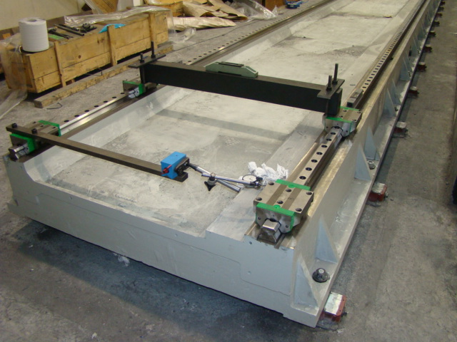
High Performance Roller Guides

Slide 11
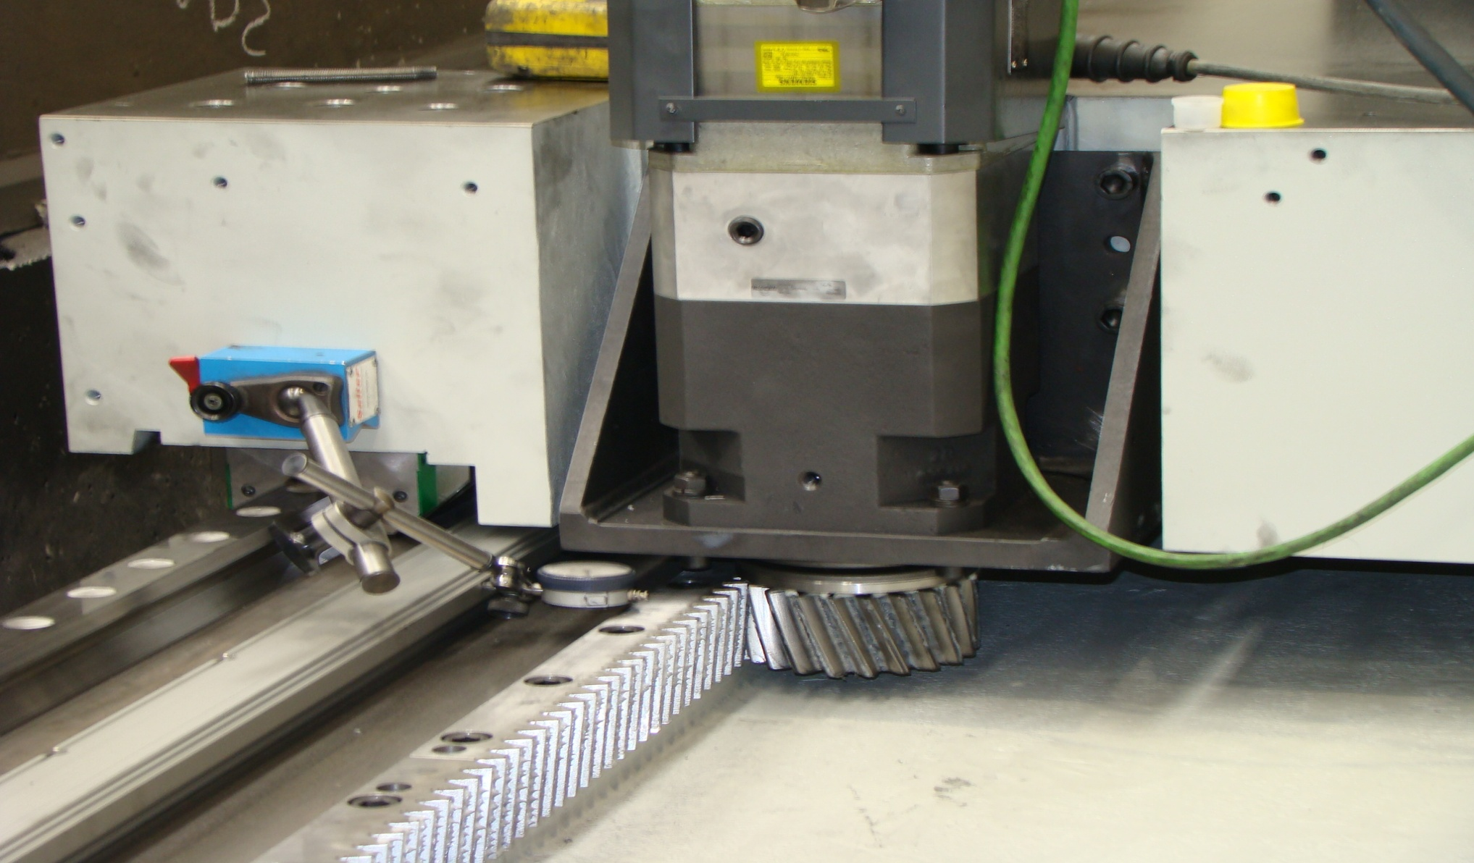
Helical Rack & Pinion Column Feed

Slide 12
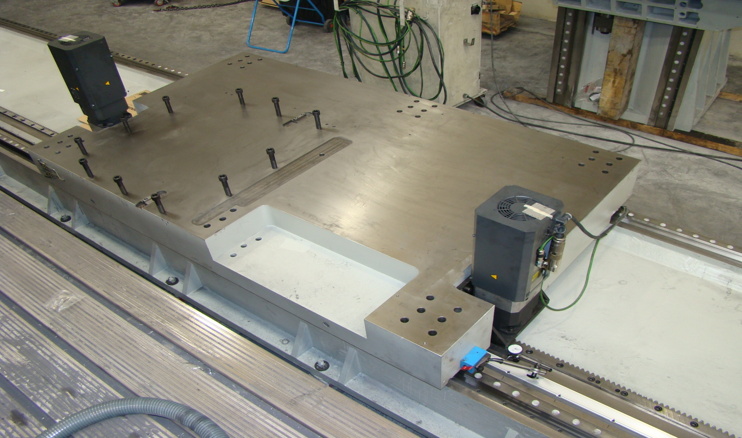
Dual Pinion Drive eliminates backlash

Slide 13
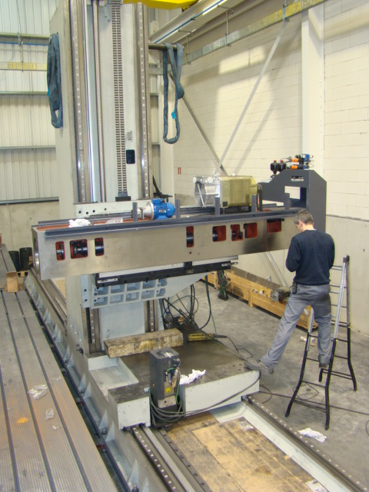
Cast Iron Column & RAM

Slide 14
Spindle Power with Torque
The 50 HP drive uses a 3 range geared transmission to provide plenty of torque for the standard 4000 RPM spindle or the optional 6000 RPM

Slide 15
Heads
Two axes Universal Head
Two axes Orthogonal head

Slide 16
Heads
Fixed Spindle Bar
Fixed Bar with right angle head

Slide 17
Automatic Head Changing
A Pick Up station provides head storage in fixed location for quick attachment and connection

Slide 18
CNC choices
Fanuc 31i
Heidenhain iTNC 530
Siemens 840D

Slide 19
Automatic Tool Changers
Universal ATC for loading vertical or horizontal head orientations
ATC platform for servicing the magazine of up to 100 tools

Slide 20
Chip management
The Thru Spindle coolant option provides 300 PSI pressure thru the tool and a paper band filtration system in addition to the standard flood coolant.
The optional chip conveyor extends the full travel of X axis catching chips underneath the spindle and disposing them at the side of the machine.

Slide 21
Machine layout & safety
Perimeter guarding with safety interlocked doors are available
The power track for the moving column is protected from chips and coolant

Slide 22
Operation
Operator cabin with CNC pendant

Slide 23
FBF with large rotary tables

Slide 24
FBF for large parts (13’H x 40’L)

Slide 25
FBF Summary
Features
- Cast Iron construction
- High performance
roller guides
- Floor type design
- RAM configuration
- Two axes head
Benefits
- Rigidity, dampening
- Faster and more accurate
- Fixed, larger parts
- Extended rigidity
- 5 side machining

Slide 26
Protected Investment
Manufactured in Spain and fully supported from the factory
USA support from United Precision Services (Cincinnati) for install, warranty parts & service, training & engineering
Local support from your dealer on common components of CNC, drives, motors, scales, switches

