Slide 2
The oldest machine-tool builder…since 1854 !
For more than 160 years, HURON GRAFFENSTADEN company thinks, designs and builds milling and lathes for cutting metal.
Tradition and modernity, constancy and adaptability, confidence and open-mindedness are the main values which form the DNA of the HURON brand.
160 years of excellency, 160 years of ingenuity, 160 of professionalism; HURON, 160 years of challenges overcame, and still a great future which keeps moving forward.

Slide 3
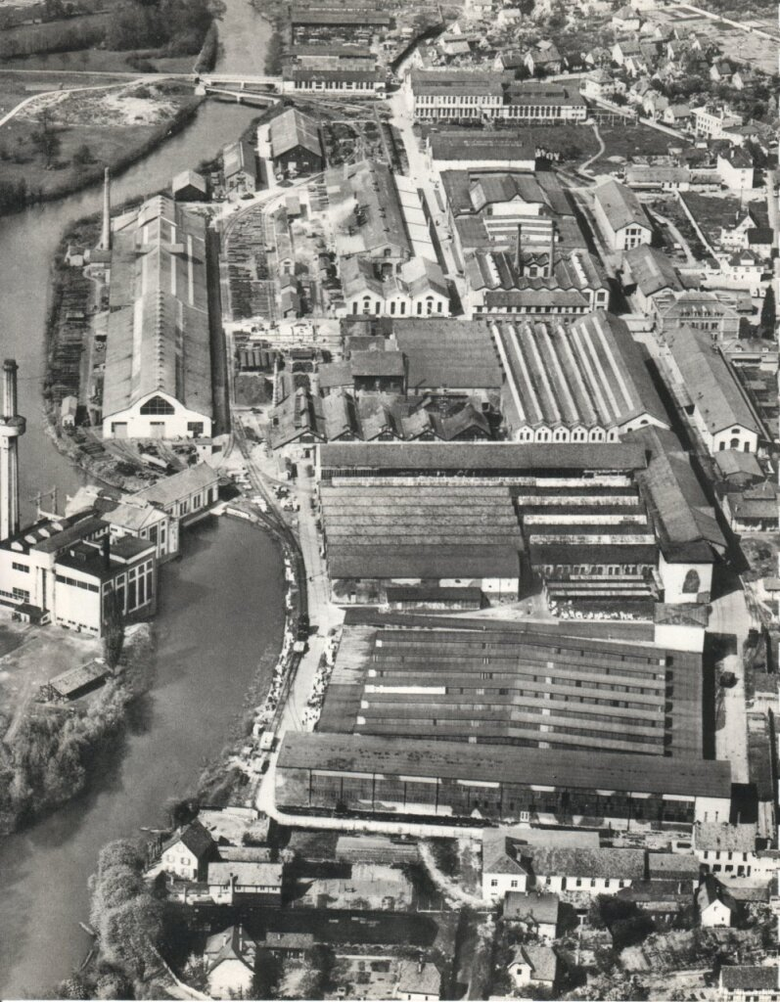
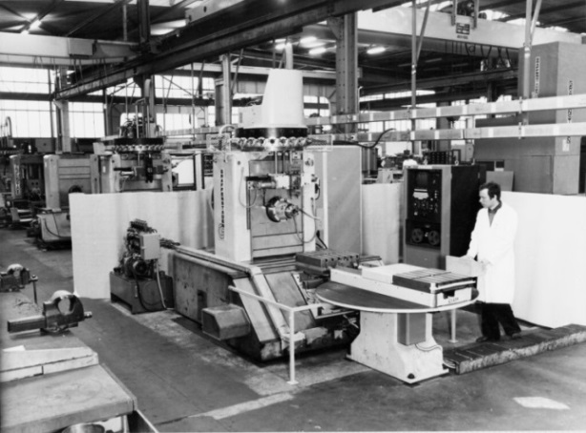
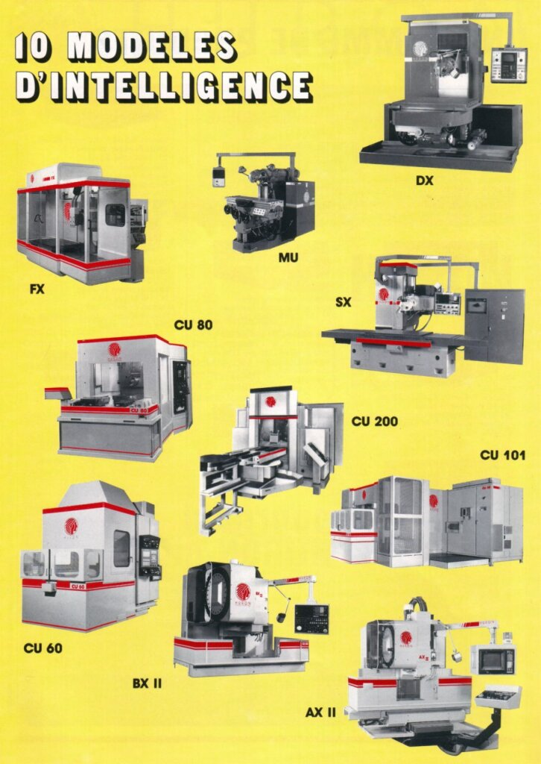
Our ADN : over 160 years of design and machines tools building
Patented in 1904
10 MODELS OF INTELLIGENCE

Slide 4
Our DNA
Boldness
Listening
Performance
Innovation
Engineering
Proximity
Creativity
Guidance and Support

Slide 5
Some figures

Slide 6
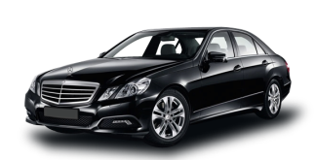
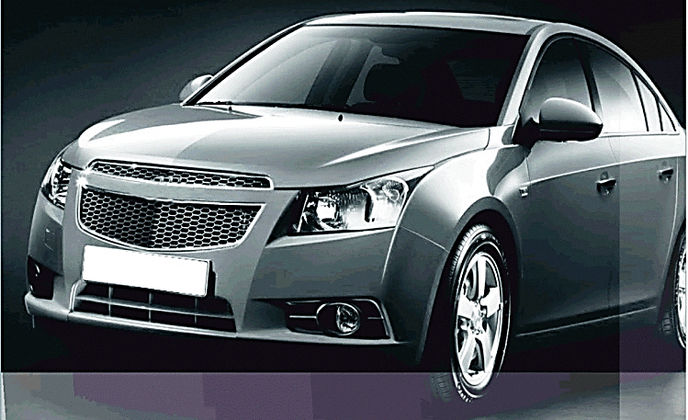
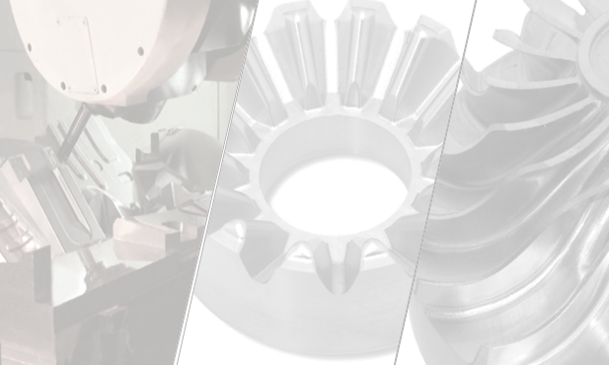
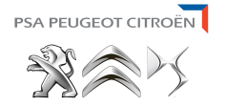
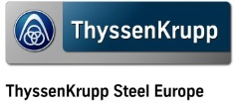
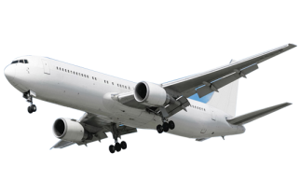
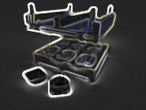
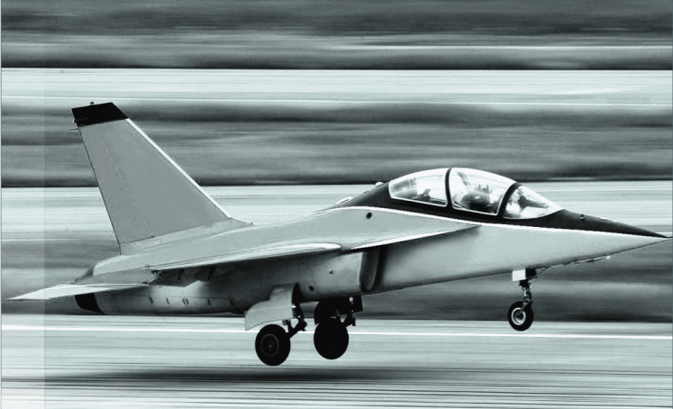
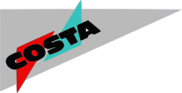
Main customers
Automobile
Mold and Die,
Precision mecanics, Energy
Mold and Die,
Precision mecanics, Energy
Aeronautics

Slide 7
Our customers worldwide
More than 100.000 machines worldwide

Slide 8
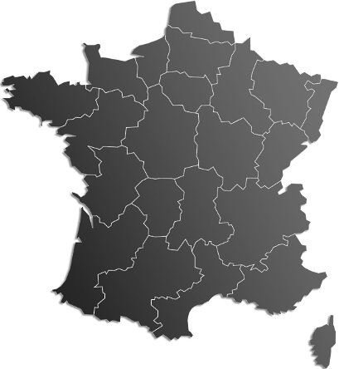
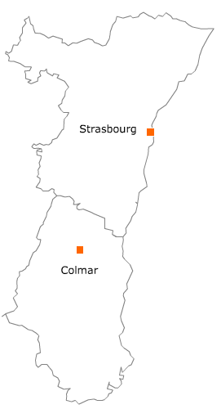
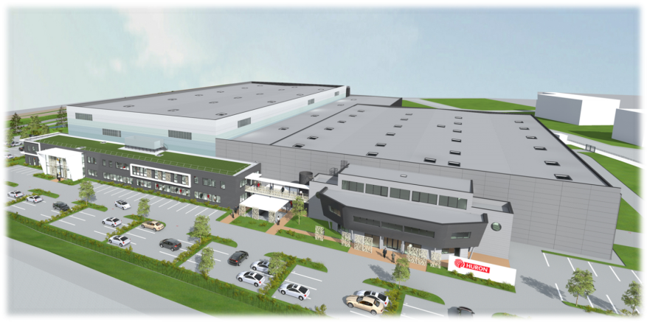
HURON in Alsace
Head office : 1 rue de l’Artisanat – 67114 ESCHAU

Slide 9
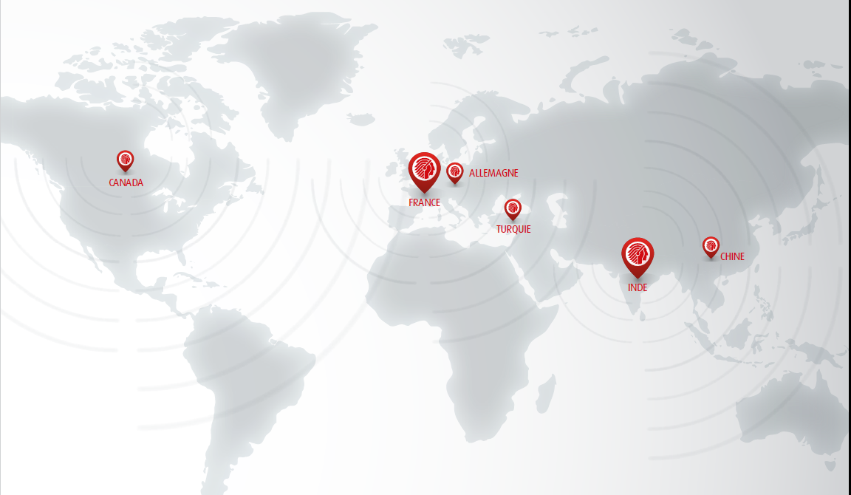
Subsidiaries and Offices

Slide 10
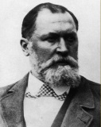
The history begins in 1838…
Branch Graffenstaden / Illkirch
Branch Huré / Paris
1838
Nicolas Koechlin associates with Pierre Schwilgué for the restoration of the astronomical clock of Strasbourg
1873
Léon Huré in Paris
1845
1st conventional milling machine
1900
Creation of the foundry
1900
1st milling machine with universal head
1958
1st NC machine
1927
Crreation of the indian head as logo and commerrcial brand

Slide 11
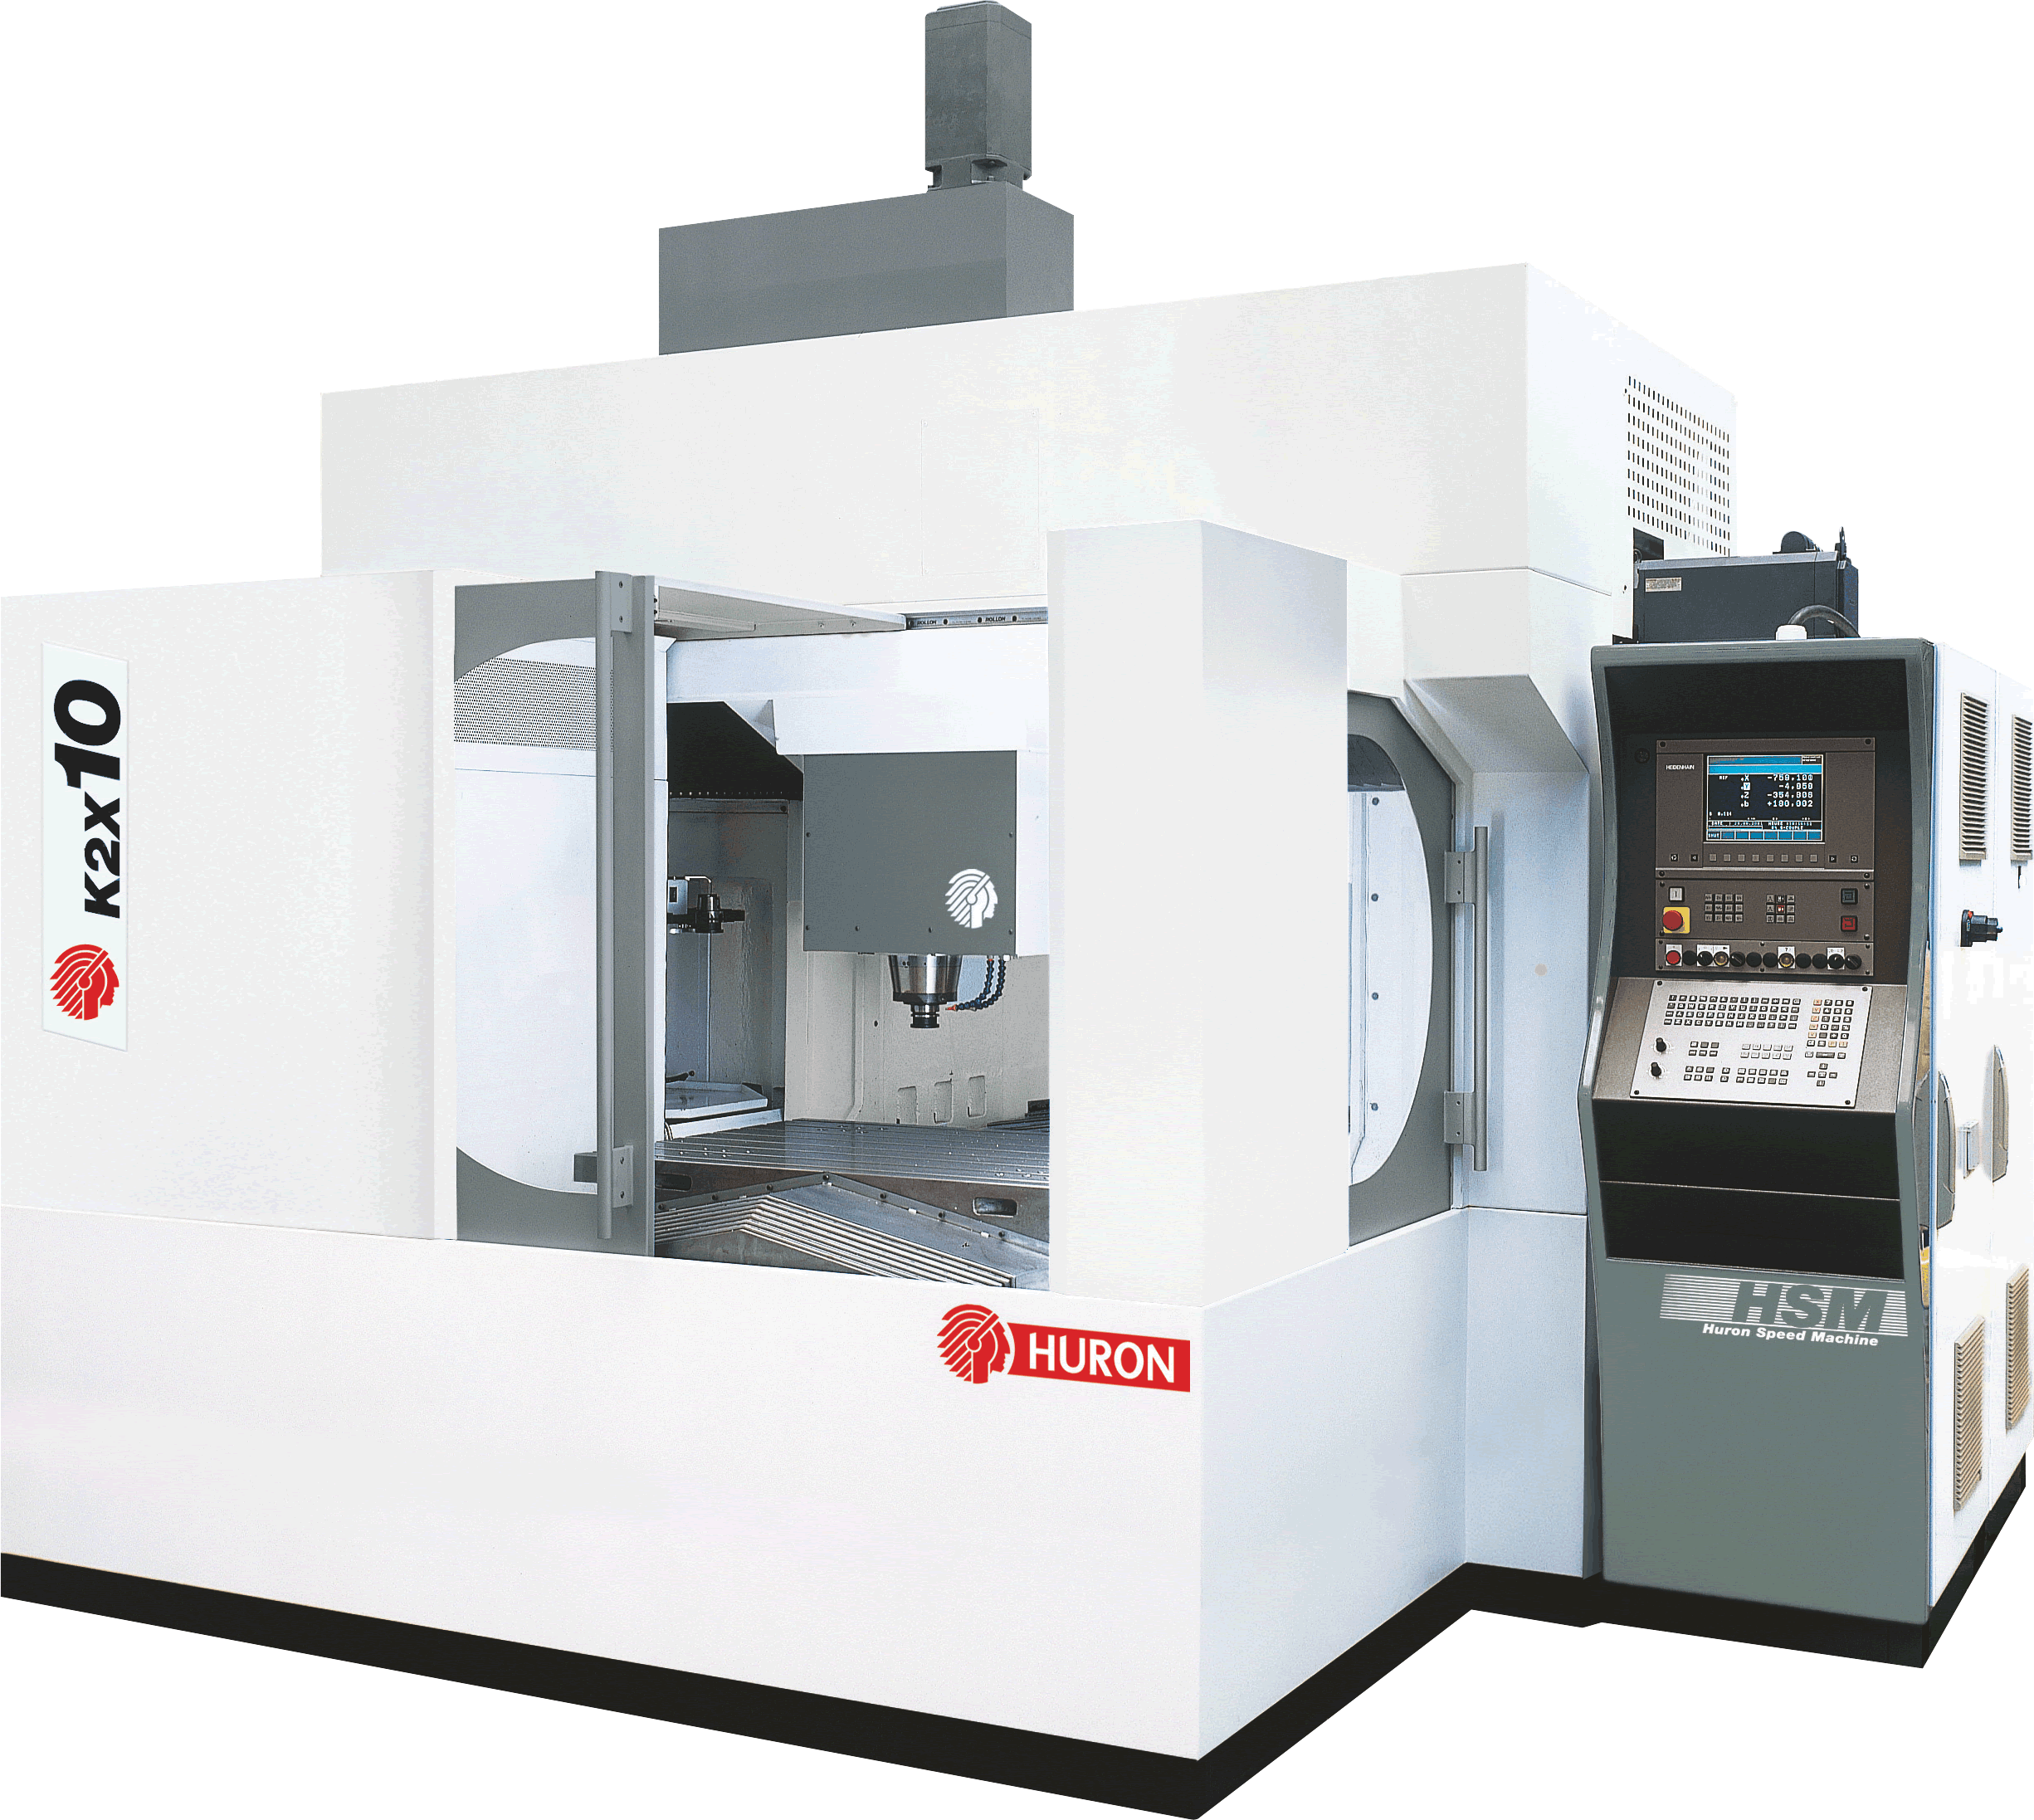
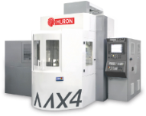
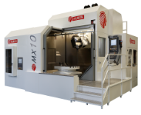
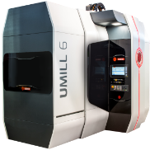
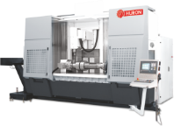
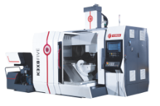
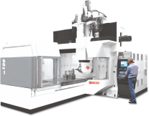
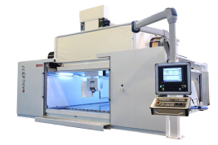
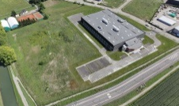
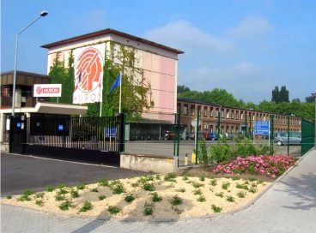
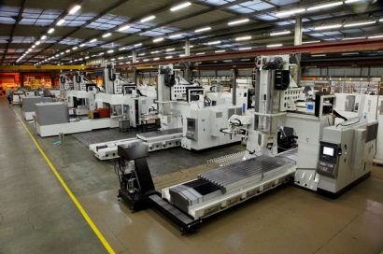
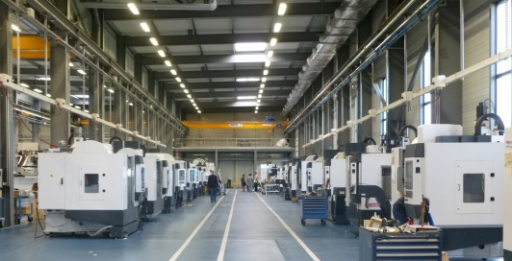
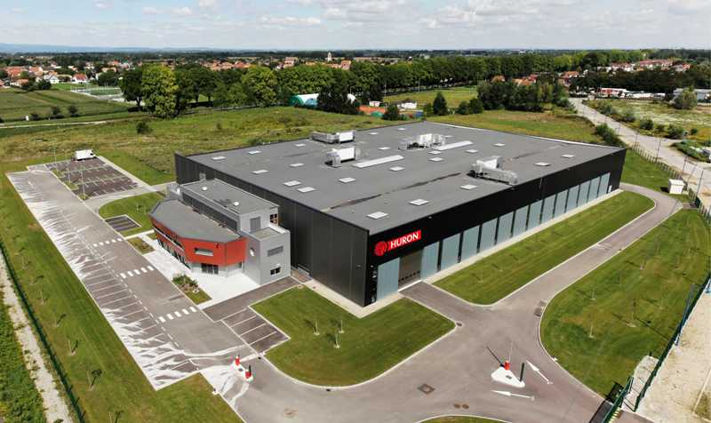
… and which is continuing!
Branche HURON / Illkirch
1987
Birth of HURON GRAFFENSTADEN
1993
1st HSM machine , EX range
1998
1st bridge and 3 axes machine
KX 10
2002
1st bridge machine 5 axes on the table KX 8 Five
2007
1st machine with integrated automation MX 4
2009
MX range launching
2016
Umill range launching
1994
HURON GRAFFENSTADEN buys GAMBIN
2000
1 ^{st} bridge machine 5 axes on the head KX 100
2005
1st Gantry machine with linear motors KXG
2007
HURON GRAFFENSTADEN joins the Indian group JYOTI AUTOMATION
2011
Purchase of a new production hall in ESCHAU

Slide 12
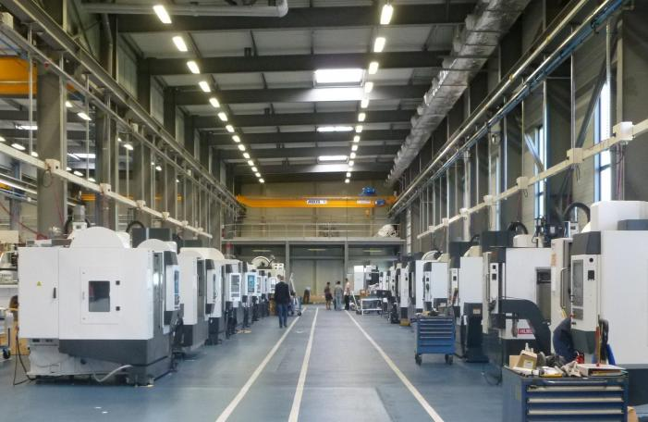
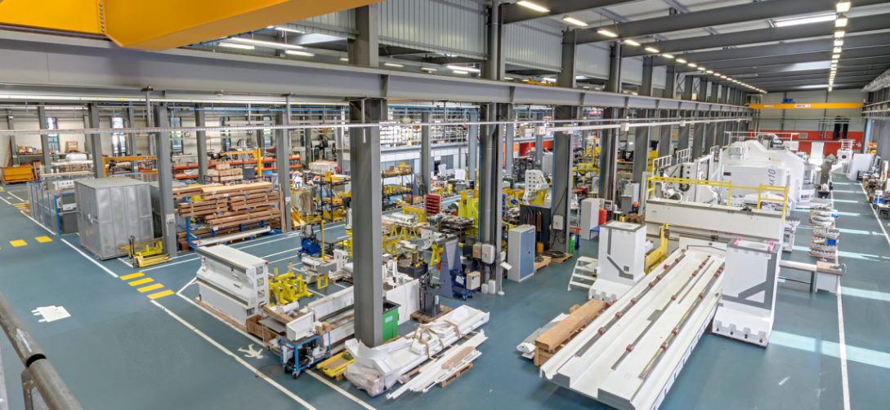
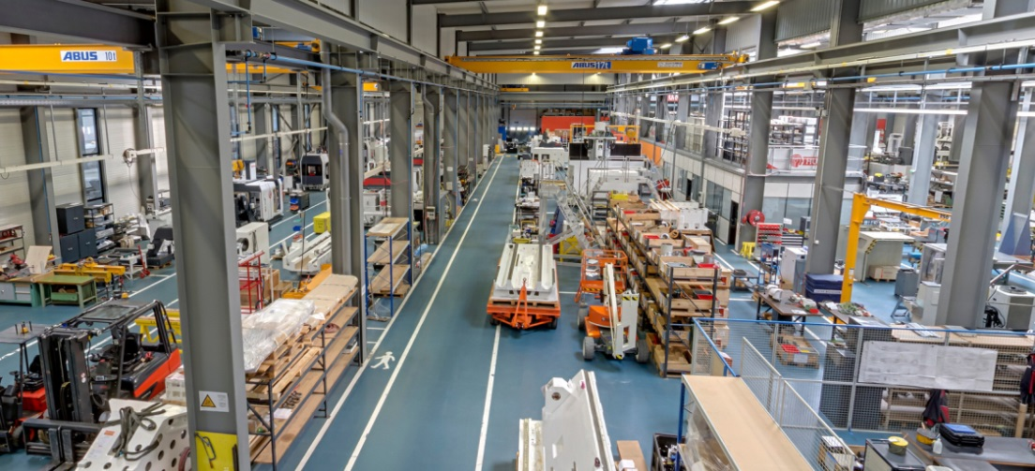
Nowadays, 1 site
Head office 2 assembly buildings
1 rue de l’Artisanat
67114 ESCHAU
FRANCE

Slide 13
Workforce
HURON =
155
people
Production
Assembly
After Sales
Mechanical
Methods
Logistics
NC integration
Purchase
Accounting
Planning
Electrical
Automaton
NC applications
Hotline
Spindle / head / table repair
Spare parts
Application
Training
Marketing
Sales
Quality
Customer Service
R&D
Others
Human Resources
IT

Slide 14
Video presentation
Note: The viewing of the video requires internet connection

Slide 15
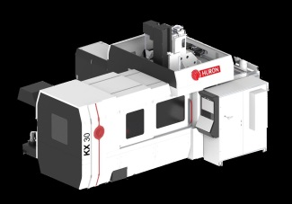
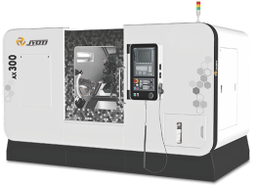
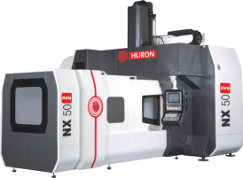
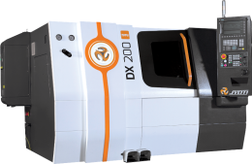
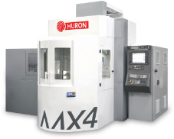
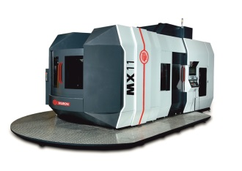
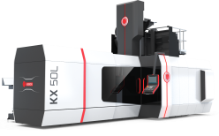
Overview
Click a Picture to access
MILLING
3 axes | VX |  | Kmill |  | KX |  | K2X
 | NX |  | Tachyon
5 axes | MX 4 |  | KX Five |  | Umill
 | KX Large |  | MX |  | KXG
TURNING
2 to 4 axes | AX
 | DX

Slide 16
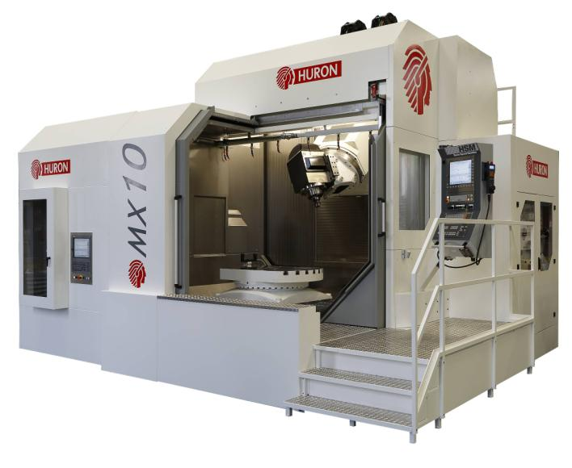
5 axis vertical milling center
MX Series
Overview
5 axis vertical milling center
Cast iron structure - moving column type
Electro-spindle
Swiveling head on 45° plane ( A axis)
Rotary table (C axis)
Rotary axes driven by torque motors
Automatic tool changer
Measuring by absolute linear scales
Ball screw direct drive
Portable handwheel
Chip conveyor
Washing gun

Slide 17
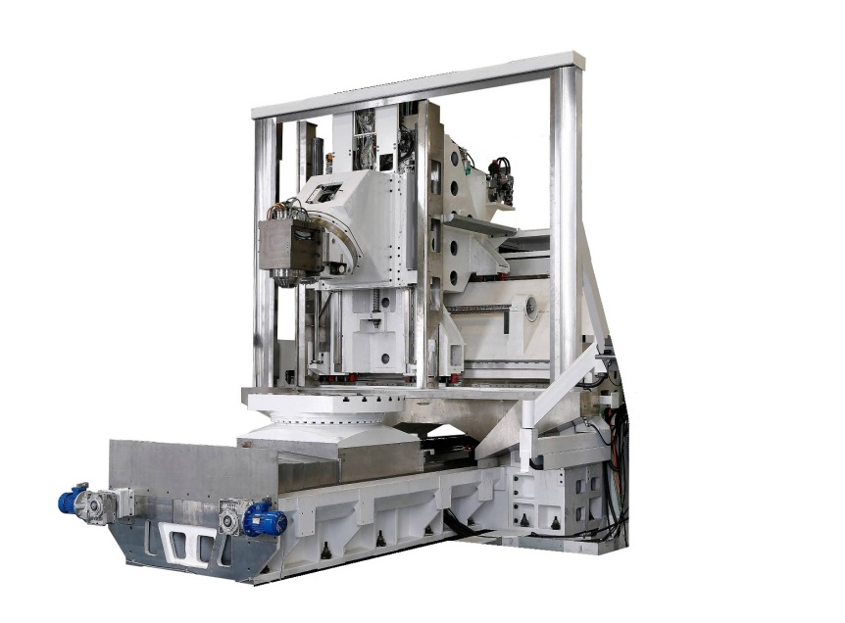
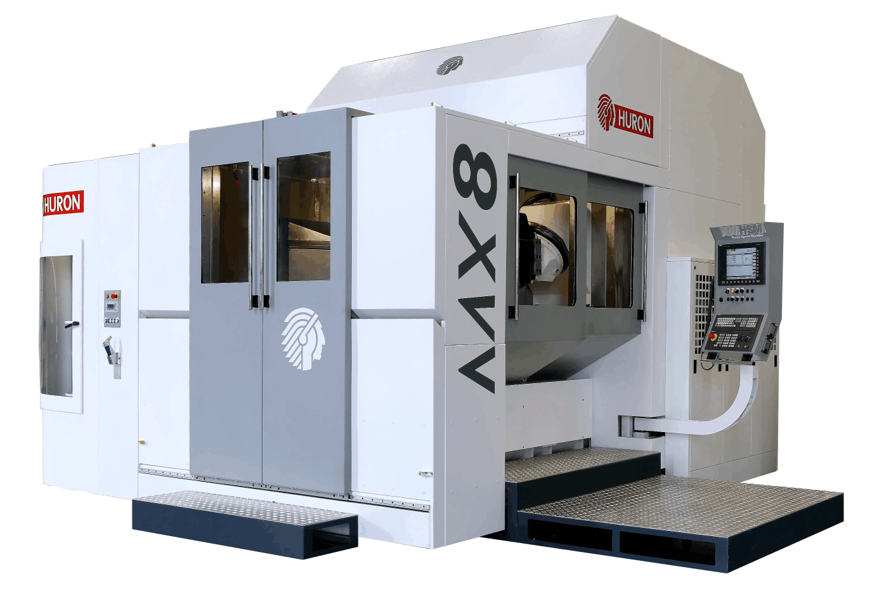
5 axis vertical milling center
Overview
 | MX 8 M | MX 8 MT
X / Y / Z | 1.160 / 1.000 / 900 mm | 1.160 / 1.000 / 900 mm
Rapid | X/Y/Z : 42 m/min | X/Y/Z : 42 m/min
Table | Ø 1.000 x 800 mm 2.000 kg – 50 rpm | Ø 800 mm 2.000 kg – 500 rpm
Spindle | 14.000 rpm – 29 kW – 277 Nm | 10.000 rpm – 43/33 kW – 415/343 Nm
Taper | HSK 63A | HSK 100A
ATC | 60 tools – twin arm | 60 tools – twin arm

Slide 18
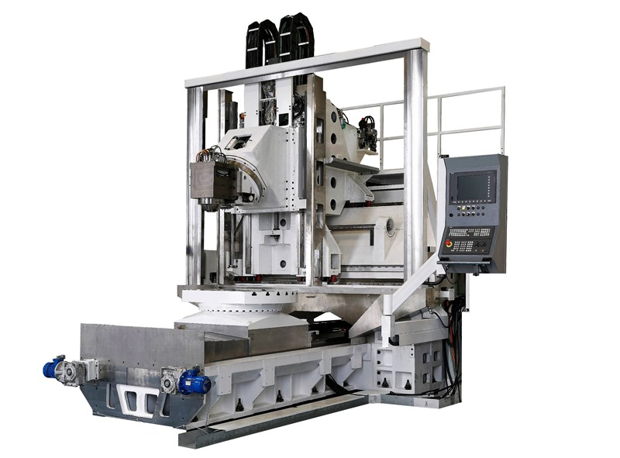
5 axis vertical milling center
Overview
 | MX 10 M | MX 10 MT
X / Y / Z | 1.200 / 1.200 / 1.000 mm | 1.200 / 1.200 / 1.000 mm
Rapid | X/Y/Z : 42 m/min | X/Y/Z : 42 m/min
Table | Ø 1.250 x 900 mm 2.500 kg – 65 rpm | Ø 1.000 mm 2.500 kg – 500 rpm
Spindle | 14.000 rpm – 29 kW – 277 Nm | 10.000 rpm – 43/33 kW – 415/343 Nm
Taper | HSK 63A | HSK 100A
ATC | 60 tools – twin arm | 60 tools – twin arm

Slide 19
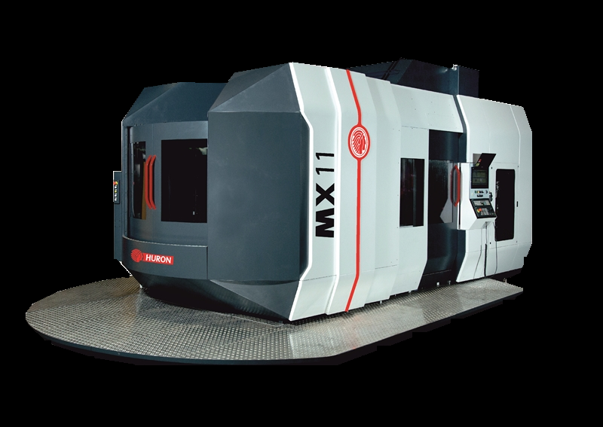
5 axis vertical milling center
Overview
 | MX 11 M APC
X / Y / Z | 1.250 / 1.250 / 1.000 mm
Rapid | X/Y/Z : 40 m/min
Table | Ø 1.000 x 800 mm 2.000 kg – 30 rpm
Spindle | 14.000 rpm – 29 kW – 277 Nm
Taper | HSK 63A
ATC | 60 tools – twin arm

Slide 20
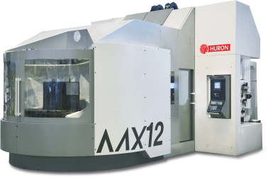
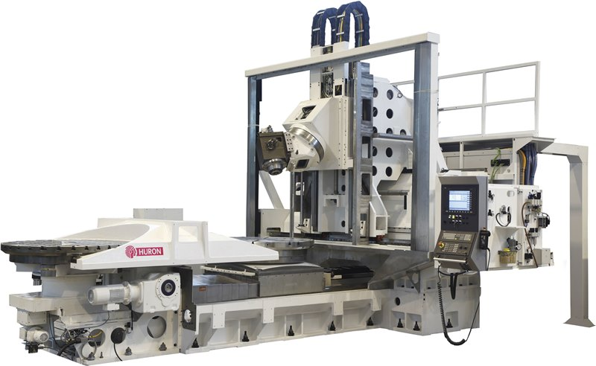
5 axis vertical milling center
Overview
 | MX 12 M | MX 12 MT
X / Y / Z | 1.200 / 1.600 / 1.000 mm | 1.200 / 1.600 / 1.000 mm
Rapid | X/Y/Z : 42 m/min | X/Y/Z : 42 m/min
Table | Ø 1.600 x 1.250 mm 4.000 kg – 50 rpm | Ø 1.400 mm 4.000 kg – 250 rpm
Spindle | 14.000 rpm– 29 kW – 277 Nm | 10.000 rpm – 43/33 kW – 415/343 Nm
Taper | HSK 63A | HSK 100A
ATC | 60 tools – twin arm | 60 tools – twin arm
NB: avec l’option palettiseur
NB: photos en version APC

Slide 21
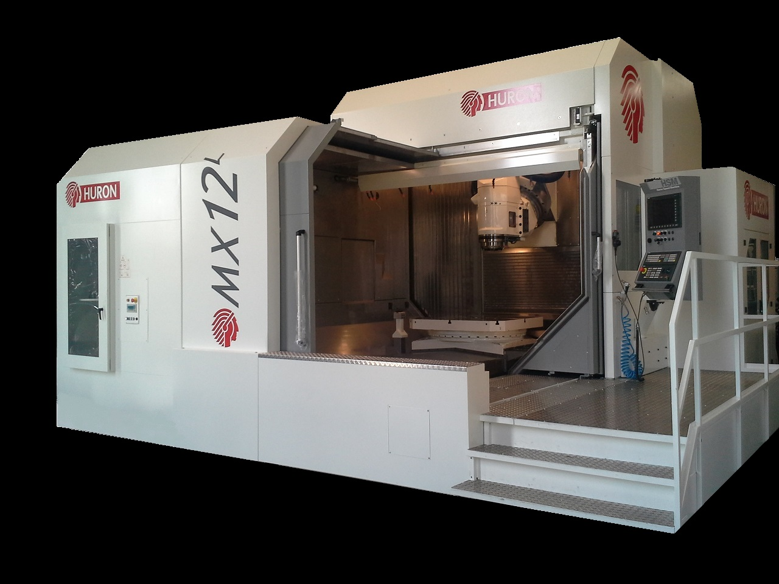
5 axis vertical milling center
Overview
 | MX 12L M
X / Y / Z | 2.000 / 1.600 / 1.000 mm
Rapid | X/Y/Z : 42 m/min
Table | Ø 1.600 x 1.250 mm 4.000 kg – 50 rpm
Spindle | 14.000 rpm – 29 kW – 277 Nm
Taper | HSK 63A
ATC | 60 tools – Twin arm

Slide 22
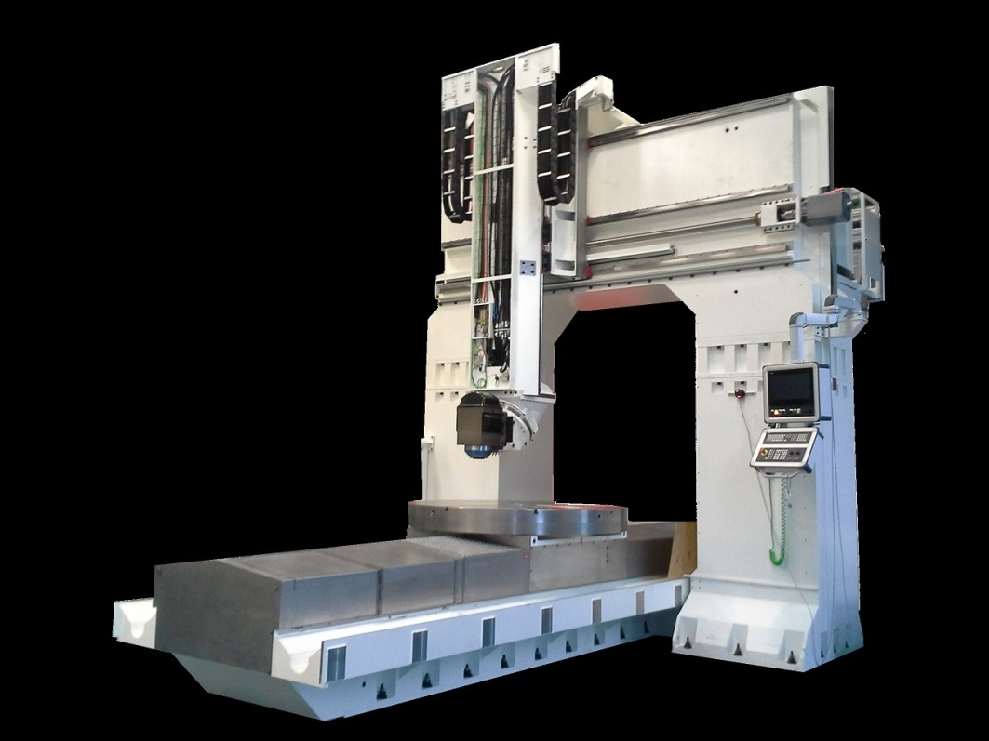
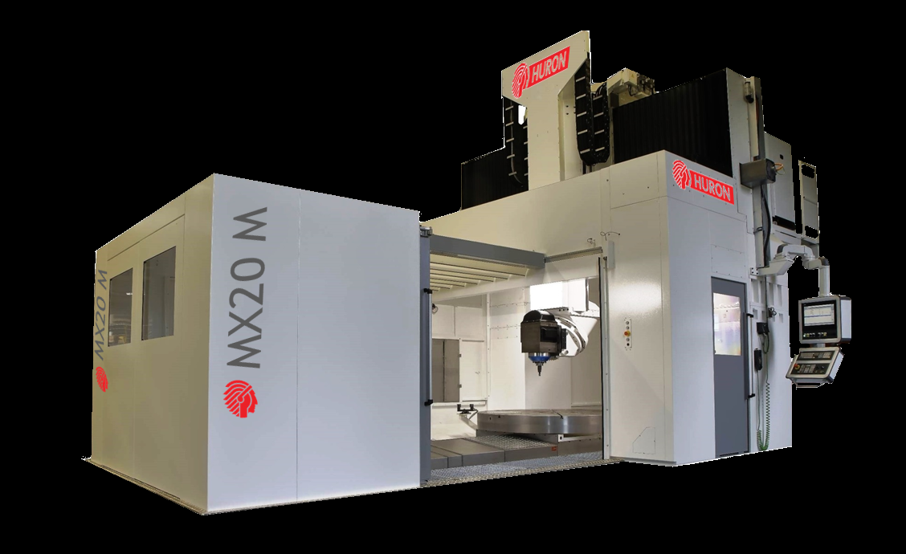
5 axis vertical milling center
Overview
 | MX 16 M | MX 20 M
X / Y / Z | 2.300 / 2.300 / 1.250 mm | 3.000 / 3.100 / 1.600 mm
Rapid | X/Y/Z : 40 m/min | X/Y/Z : 20 m/min
Table | Ø 1.750 mm 10.000 kg – 9 rpm | Ø 2.200 mm 12.000 kg – 7 rpm
Spindle | 10.000 rpm – 43/33 kW – 415/343 Nm | 10.000 rpm– 43/33 kW – 415/343 Nm
Taper | HSK 100A | HSK 100A
ATC | 60 tools – twin arm | 60 tools – twin arm

Slide 23
5 axis vertical milling center
Overview
MX 16 / MX 20
What is changing compared to the rest of
the range !
Fixed bridge structure - MX 16 : Cats-iron structure - MX 20 : Polymer concrete structure
Rotary axis : - A : driven by torque motors - C : driven by worm and wheel
Linear axes drive : - MX 16 : direct drive ball screws - MX 20 : X = rack-and pinion Y/Z = direct drive ball screws

Slide 24
5 axis vertical milling center
KX Large Series – KX 50 M/L
Overview
5 axis vertical milling center
Cast iron structure – Bridge type machine
Electro-spindle
2 axes forkhead (B + C axes)
Rotary axes driven by torque motors
Moving table
Automatic tool changer
Measuring by absolute linear scales
Direct drive ball screw
Portable handwheel
Chip conveyor
Washing gun

Slide 25
5 axis vertical milling center
Overview
 | KX 50 M | KX 50 L
X / Y / Z | 2.000 / 1.700 / 900 mm | 3.000 / 1.700 / 900 mm
Rapid | X/Y/Z : 40 m/min | X/Y/Z : 40 m/min
Table | 2.200 x 1.250 mm – 4.000 kg | 3.300 x 1.250 mm – 6.000 kg 6.000 kg with acceleration 2,4 m/s² 2.500 kg with acceleration 4 m/s²
Spindle | 20.000 rpm – 75/60 kW – 75/60 Nm | 20.000 rpm – 75/60 kW – 75/60 Nm
Taper | HSK 63A | HSK 63A
ATC | 30 tools – Pick-up | 30 tools – Pick-up

Slide 26
5 axis vertical milling center
Overview
KX Large Series – KX 100 / 200 / 300
5 axis vertical milling center
Cast iron structure - Bridge type machine
! Concrete structure for KX 300
Electro-spindle
2 axes head ( B + C axes)
Rotary axes driven by torque motors
Moving table
Automatic tool changer
Measuring by absolute linear scales
Ball screws direct drive
Portable handwheel
Chip conveyor
Washing gun
Note : forthcoming migration towards the new design

Slide 27
5 axis vertical milling center
Overview
 | KX 100 | KX 200
X / Y / Z | 2.300 / 2.300 / 1.000 mm | 3.300 / 2.300 / 1.000 mm
Rapid | X/Y/Z : 40 m/min | X : 25 m/min – Y/Z : 40 m/min
Table | 2.500 x 1.250 mm – 12.000 kg 12.000 kg with accekeration 2,4 m/s² 6.000 kg with acceleration 4 m/s² | 3.500 x 1.250 mm – 12.000 kg 12.000 kg with acceleration 2,4 m/s² 9.000 kg with acceleration 4 m/s²
Spindle | 18.000 rpm – 30/20 kW – 240/160 Nm | 18.000 rpm – 30/20 kW – 240/160 Nm
Taper | HSK 63A | HSK 63A
ATC | 40 tools – Pick-up | 40 tools – Pick-up
Note : forthcoming migration towards the new design

Slide 28
5 axis vertical milling center
Overview
 | KX 300
X / Y / Z | 5.000 / 3.100 / 1.500 mm
Rapid | X/Y/Z : 20 m/min
Table | 5.200 x 2.000 mm – 20.000 kg 20.000 kg with acceleration1,5 m/s² 13.000 kg with acceleration 2 m/s²
Spindle | 18.000 rpm – 30/20 kW – 240/160 Nm
Taper | HSK 63A
ATC | 40 tools – Pick-up

Slide 29
5 axis vertical milling center
KXG Series
Overview
5 axis vertical milling center
Gantry type
Fixed structure and concrete walls
Welded construction of moving parts
Electro-spindle
2 axes forkhead (B + C axes)
Rotary axes driven by torque motors
Fixed table
Automatic tool changer
Measuring by absolute linear scales
X axis drive KXG-P : rack and pinion KXG-L : linear motor
Direct drive by ball screw on Y/Z axes
Portable handwheel
Chip conveyor
Washing gun

Slide 30
5 axis vertical milling center
Overview
 | KXG 30-15
X / Y / Z | 3.000 / 1.500 / 800 mm Note : as well available with Z = 1.250 mm
Rapid | X/Y : 60 m/min – Z : 45 m/min
Table | 3.000 x 1.500 mm – 13.000 kg
Spindle | 20.000 rpm– 75/60 kW – 75/60 Nm
Taper | HSK 63A
ATC | 40 tools – Pick-up

Slide 31
5 axis vertical milling center
Overview
 | KXG 45-15 | KXG 45-25
X / Y / Z | 4.500 / 1.500 / 800 mm NB : as well available with Z = 1.250 mm | 4.500 / 2.500 / 800 mm NB : as well available with Z = 1.250 mm
Travels | X/Y : 60 m/min – Z : 45 m/min | X/Y : 60 m/min – Z : 45 m/min
Table | 4.700 x 1.390 mm – 18.000 kg | 4.700 x 2.480 mm – 21.000 kg
Spindle | 20.000 rpm – 75/60 kW – 75/60 Nm | 20.000 rpm – 75/60 kW – 75/60 Nm
Taper | HSK 63A | HSK 63A
ATC | 40 tools – Pick-up | 40 tools – Pick-up

Slide 32
5 axis vertical milling center
Overvies
 | KXG 60-25 | KXG 90-25
X / Y / Z | 6.000 / 2.500 / 800 mm NB : as well available with Z = 1.250 mm | 9.000 / 2.500 / 800 mm NB : as well available with Z = 1.250 mm
Rapid | X/Y : 60 m/min – Z : 45 m/min | X/Y : 60 m/min – Z : 45 m/min
Table | 6.200 x 2.480 mm – 25.000 kg | 9.000 x 2.480 mm – 52.000 kg
Spindle | 20.000 rpm – 75/60 kW – 75/60 Nm | 20.000 rpm – 75/60 kW – 75/60 Nm
Taper | HSK 63A | HSK 63A
ATC | 40 tools – Pick-up | 40 tools – Pick-up

Slide 33
5 axis vertical milling center
Overview
 | KXG 60-25 Twin | KXG 90-25 Twin
X / Y / Z | 6.000 / 2.500 / 800 mm Note : as well available with Z = 1.250 mm | 9.000 / 2.500 / 800 mm NB : as well available with Z = 1.250 mm
Rapid | X/Y : 60 m/min – Z : 45 m/min | X/Y : 60 m/min – Z : 45 m/min
Table | 6.200 x 2.480 mm – 25.000 kg | 9.000 x 2.480 mm – 52.000 kg
Spindle | 20.000 rpm – 75/60 kW – 75/60 Nm | 20.000 rpm – 75/60 kW – 75/60 Nm
Taper | HSK 63A | HSK 63A
ATC | 40 tools – Pick-up | 40 tools – Pick-up

Slide 34
5 axis vertical milling center
KX Five Series
Overviewre
5 axis vertical milling center
Cast iron structure – bridge type
Electro-spindle
2 axes swiveling table (A + C axes)
Rotary axes driven by torque motors
Automatic tool changer
Measuring by absolute linear scales
Ball screw direct drive
Portable handwheel
Chip conveyor
Washing gun

Slide 35
5 axis vertical milling center
Overview
 | K3X 8 Five
X / Y / Z | 780 / 700 / 500 mm
Rapid | X/Y/Z : 50 m/min
Table | Ø 500 mm – 300 kg (250 kg without travel limitation ) A axis clearance= +30°/-180° Negative angle = -20° C axis rotation = 360°
Spindle | 18.000 rpm – 30/30 kW – 110/84 Nm
Taper | HSK 63A
ATC | 36 tools – Twin arm
 | K2X 10 Five
X / Y / Z | 900 / 900 / 500 mm
Rapid | X/Y/Z : 50 m/min
Table | Ø 800 mm – 750 kg (500 kg without acceleration limitation) A axis clearance= +45°/-180° C axis rotation = 360°
Spindle | 24.000 rpm– 25/20 kW – 40/32 Nm
Taper | HSK 63A
ATC | 36 tools – Twin arm

Slide 36
5 axis vertical milling center
MX 4
Overview
5 axis vertical milling center
Electro-spindle
Bridge type cast iron structure
2 axes swiveling table (A + C axes)
Integrated APC 2 pallets
Rotary axes driven by torque motor
Axes drive - X = by ball screws - Y and Z = by linear motor
Measuring by absolute linear scales
Automatic tool changer
Portable handwheel
Chip conveyor
Washing gun

Slide 37
5 axis vertical milling center
Overview
 | MX 4
X / Y / Z | 750 / 700 / 500 mm
Travels | X : 60 m/min – Y/Z : 120 m/min
Palletized table | 400 x 400 mm – 250 kg A axis clearance = -45°/+180° C axis rotation = 360°
Spindle | 24.000 rpm – 25/20 kW – 40/32 Nm
Taper | HSK 63A
ATC | 36 tools – Pick-up

Slide 38
3 axis vertical milling center
NX Series
Sommaire
3 axis vertical milling center
Vertical belt-driven spindle
Bridge type cast iron structure
Moving table
Ball screws direct drive
Measuring by absolute linear scales
Automatic tool changer
Portable handwheel
Chip conveyor
Washing gun

Slide 39
3 axis vertical milling center
Overview
 | NX 40 | NX 50 | NX 60
X / Y / Z | 2.200 / 1.500 / 800 mm | 3.200 / 1.500 / 800 mm | 3.200 / 2.200 / 800 mm
Rapid | X/Y : 20 m/min – Z : 15 m/min | Y/Z : 15 m/min – Y: 20 m/min | X/Y/Z : 15 m/min
Table | 2.200 x 1.250 mm – 6.000 kg | 3.000 x 1.250 mm – 8.000 kg | 3.000 x 2.000 mm – 10.000 kg
Spindle | 6.000 rpm – 32,3/21,5 kW – 170/117 Nm
Taper | ISO 50
ATC | 40 tools – Twin arm

Slide 40
Gamme de produits
MILLING
TURNING
&

Slide 41
Overview
Click a picture to access
MILLING
3 axis | VX |  | Kmill |  | KX |  | K2X
 | NX |  | Tachyon
5 axis | MX 4 |  | KX Five |  | Umill
 | KX Large |  | MX |  | KXG
TURNING
2 to 4 axis | AX
 | DX

Slide 42
Thank you for your attention

Slide 43
Follow us …

